Slide 1

Murphys Sanitation District
Rate Study Workshop
March 6, 2025
Note: All figures are DRAFT until the Public Hearing

Slide 2
Why a Rate Study Now?
Current rates and rate structure in place since 2009
Cost of Service analysis required to ensure compliance with current laws
Fund capital improvements projects (CIP) identified in the 2024 Master Plan.
Review of the current financial health of the District to operate the wastewater system for the next 5 years, disposing of wastewater responsibly while meeting all regulatory requirements.
Determine efficacy of current residential and commercial rates to support projected costs.
Secure adequate reserves to ensure sufficient cash flow, fund capital improvements and provide funds for emergencies.

Slide 3
Rate Setting Process

Slide 4
Revenue Sufficiency
Simple & Logical
Utility Billing Compatible
Signal Value of Service
Support District Goals
Multiple
Objectives

Slide 5

Revenue Requirement
Determine funding needed to meet financial needs
  Operations & Maintenance
  Capital Improvements
  System Rehabilitation
  Debt Service
  Prudent Reserves
Notes:
Depreciation:
The accounting term for the cost of System Rehabilitation
Recovering the cost of an asset over its estimated lifetime
Different methods of calculation
Most widely used is a “straight-line”

Slide 6
District runs a ‘Business-Type Activity’
Self-sufficient Fund
Funded 77% by User Rates
Exclusive for Wastewater Service
Last rate increase in 2009
Since then, inflation alone has increased prices 56%*
  Cost of Wastewater Service for a Home $60 per month since 2009 would be $93 per month now
  Another example – Nationally, the average price Gallon of Milk $3.11 in 2009; it is $4.33 in 2025 (39% increase)
  *West Region CPI

Slide 7
Operations & Capital Costs
Operating costs paid for with rates, investment income, and miscellaneous other
Capital costs paid for with combination of rates, property taxes, connection fees, investment income, and loans/grants
    Rates and property taxes pay for rehabilitation or replacement of assets providing capacity to service existing customers
    Connection fees pay for increased capacity in rehabilitated assets and new assets to service new customers

Slide 8
Current Wastewater Fund
Operating Expenses
Source: Fiscal year 21-24 (last 4 years) data

Slide 9
Projected Costs
Operating Costs increase 5.0% to 6.0% each year
System Rehabilitation in the CIP
Credits for investment income & miscellaneous revenues
Current Debt Service
New State Revolving Fund debt service for Influent Force Main & Wastewater Treatment Plant Phase 2
New USDA debt service for collection system (pipeline) replacements

Slide 10
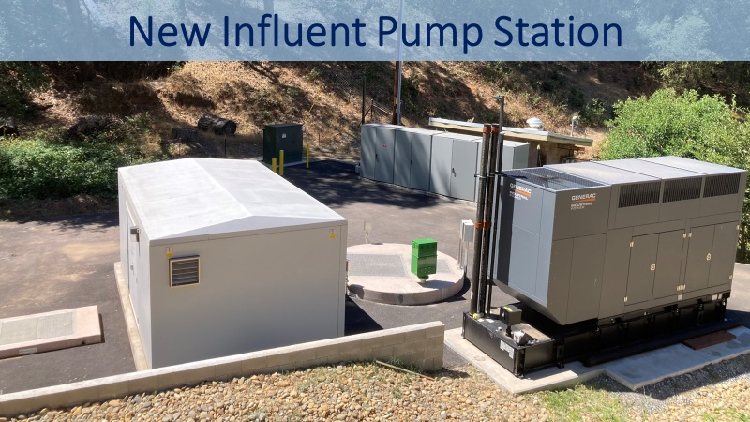
Capital Improvements

Slide 11
Master Plan Capital Improvement Projects Estimated Cost in Inflated $’s
Project Type | Estimated Cost
 | Next 5 Yrs | Yrs 6 - 9
Collection System | $6,618,950 | $8,080,900
Treatment Plant | $2,251,260 | $0
Building & Equipment | $1,877,360 | $10,880
Total Estimated Cost | $10,747,570 | $8,091,780
Loan Funded | $8,870,210 | $5,623,680
Rates Funded | $1,877,360 | $2,468,100

Slide 12
CIP Funding Strategy
Estimated Funding Sources
Millions of Dollars

Slide 13
Sanitary Sewer Collection System
Existing Infrastructure
Existing Gravity Collection System (Piping)
Manholes
Influent Pump Station
Influent Force Main
Need for Improvements
Replace antiquated and undersized infrastructure
To decrease Sanitary Sewer Overflows (SSOs)
Reliability and Redundancy
Improve overall operation and maintenance of the system

Slide 14
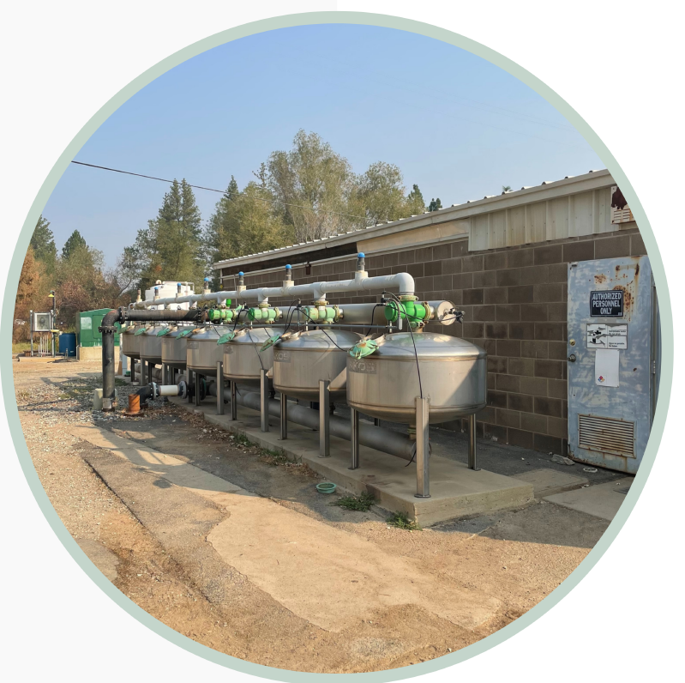
Wastewater Treatment Plant
Existing Infrastructure
Headworks
Screening Facilities
Treatment Ponds (Pond 1-3)
Effluent Storage Pond (Pond 4)
Sand Filtration System
Disinfection System
Chlorine Contact Basin
Lined Detention Basin (Finish/Polishing Pond)

Slide 15
Wastewater Treatment Plant
Need for Improvements
Replace aging and inefficient infrastructure and equipment
Allow the District to meet Title 22 Standards
Improve overall operation and efficiency
Reliability and Redundancy – Backup Power
Improved Safety and Security
Improved treatment and capacity

Slide 16
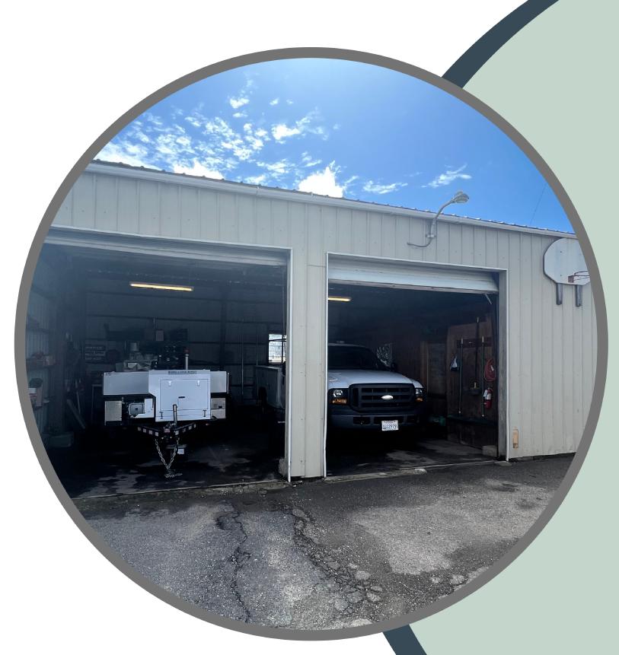
Operations & Maintenance Equipment
Existing Infrastructure
Maintenance Vehicles
Security and Sewer Cameras
Hydro Flusher
Need for Improvements
Reliability of Maintenance Equipment and Vehicles
Improve Safety and Security
Improve operations and efficiency
Upgrade Technology (computers and software)

Slide 17
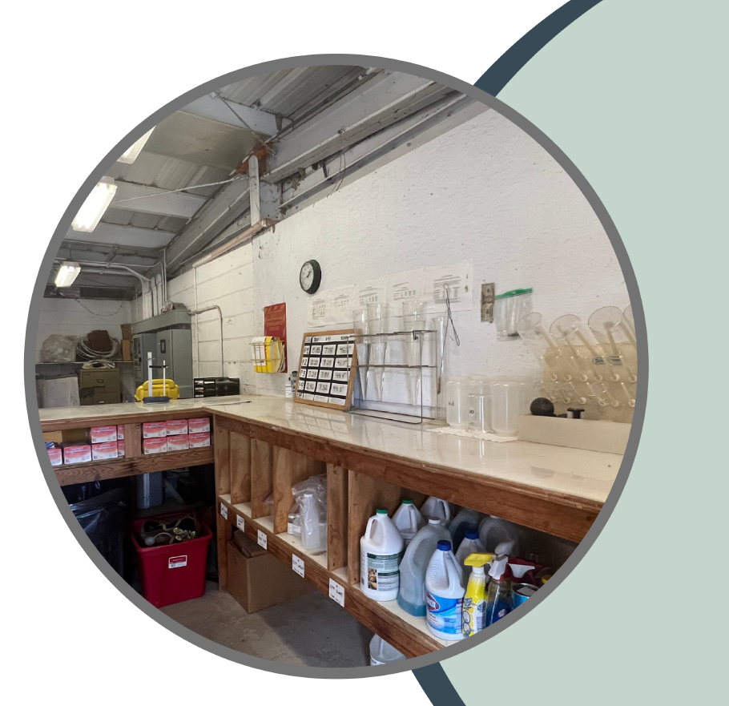
WWTP Building and Facilities
Existing Infrastructure
Office Building
Maintenance Facility
Need for Improvements
Existing building leaks
Buildings are antiquated and beyond useful life
Improve operation and maintenance (included lab area)

Slide 18
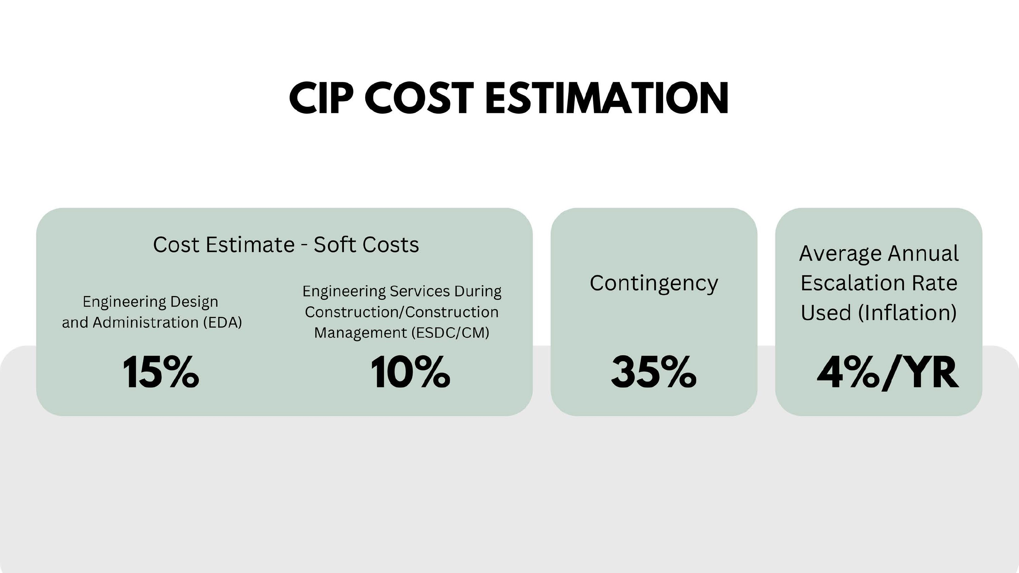

Slide 19
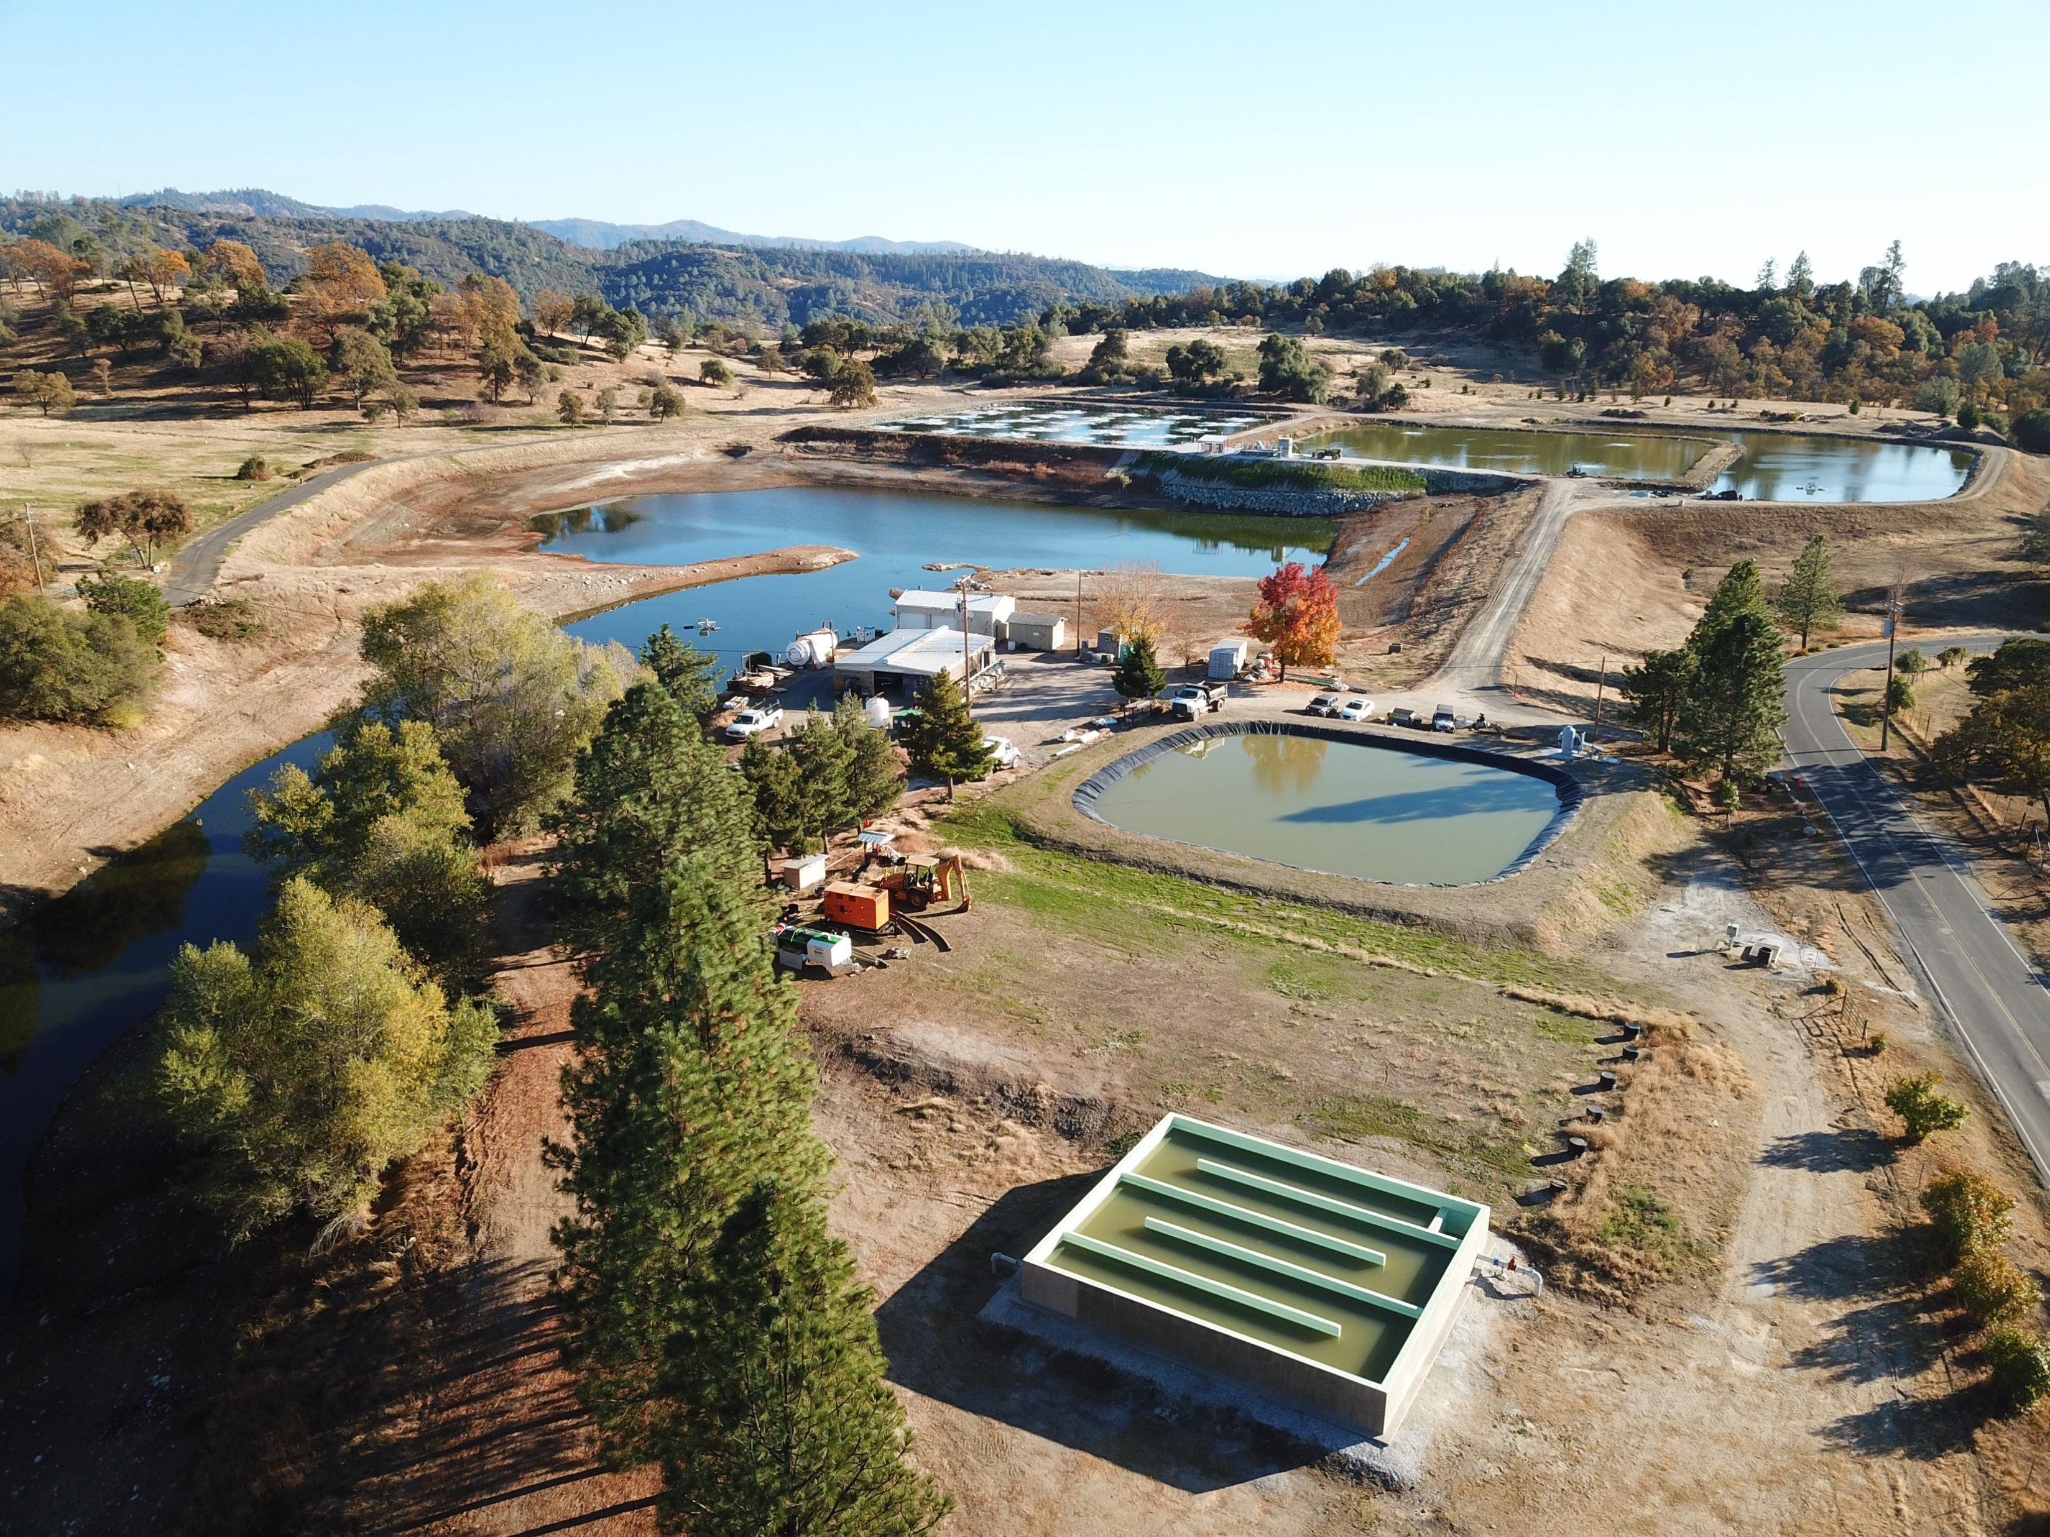
Rate Structure

Slide 20
Current Rate Structure
Need to change the structure as billing per resolution is infeasible
Murphys SD non-residential accounts do not match UPUD accounts
(ex: 1 water meter serves 3 buildings; Murphys has 3 wastewater accounts)

Slide 21
Rate Structure Modifications
Two Key Changes Proposed:
Monthly flat charge comprised of 2 components
Base Charge + Flow Charge
  Charge per Account for Service Availability + Charge for Use of the System
  2. Flow Charge accounts for treatment expense:
  Currently, customers charged for Flow only
  Proposal is to charge customers for Flow and Strength
    Reflects the cost difference to treat the wastewater received by different customer types

Slide 22
Cost to Treat Wastewater per Thousand Gallons

Slide 23
Proposed Change in Billing Units Methodology for Flow Charges
Residential NO CHANGE – each dwelling unit is a billing unit
Non-Residential Methodology to count Billing Units by Account:
  Number of wastewater connections or Number of businesses served by the account, and
  Water use for the type of business
  The units of measurement change for these customers from per EDU to:
  Schools – per Student
  Hotels/Motels – per Room
  Car Washes – per Facility
  Grocery Stores – per Store
  Churches – per Church

Slide 24
Calculated Rate Schedule

Slide 25
Bill Impact: Home
Monthly Bill = Base Charge + Flow Charge
$80.30 = $23.42 + $56.88 for FY26

Slide 26
FY26 (First Year) Impacts to Homes & Vacant Lots
Decrease for Seniors Village 55+

Slide 27
Sample Non-Residential FY26 Bill Impacts
Sample bills for selected business accounts.
Results will not be the same for all business accounts.

Slide 28
Sample Non-Residential FY26 Bill Impacts
Sample bills for selected business accounts.
Results will not be the same for all business accounts.

Slide 29
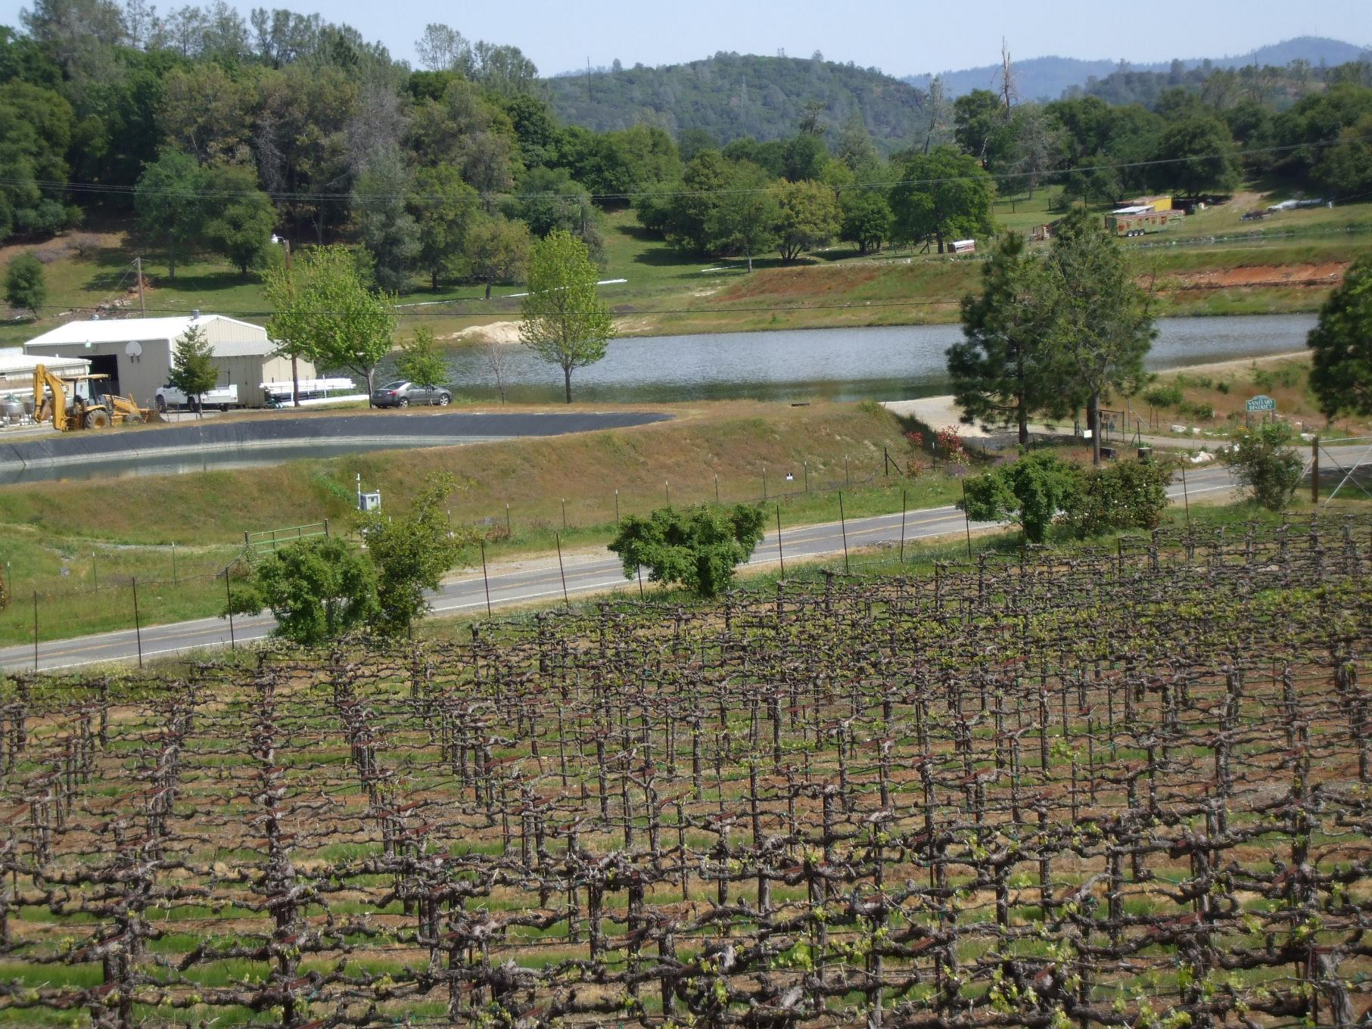
Next Steps: Rate Adoption

Slide 30
Proposition 218 Requirements
Revenues from the fee shall not exceed funds required to provide the service.
Revenues from the fee shall not be used for any purpose other than that for which it was imposed.
The amount of the fee imposed as an incident of property ownership shall not exceed the proportional cost of service to the parcel.
No fee may be imposed for service unless the service is used OR is immediately available to the parcel.
No fee may be imposed for general governmental services (such as police, fire, library) where the service is available to the public at large in much the same manner as to the parcels charged the fee.

Slide 31
Adoption Timeline
March 13
Board Mtg decision to proceed with proposed rates
45-day Noticing Period
Customers opportunity to review proposed rates
May 8
Acceptance of Final Report, Public Hearing, & Ordinance
March 1-6
Draft Report Available & Public Workshop
July 1
New Rates Implemented

